Slide 1
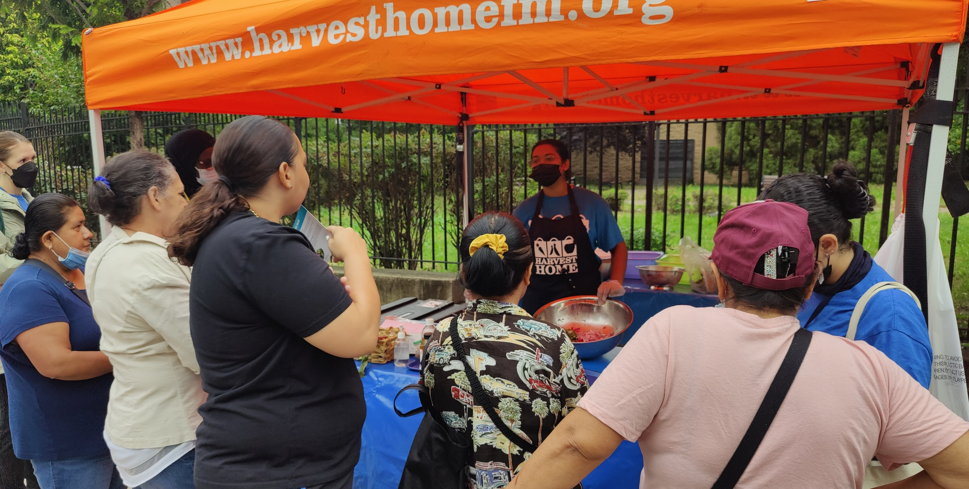
Eating For Good Health (EFGH) Survey Results 2023

Slide 2
Demographics: Gender
The Bronx continues to have the largest number of visitors followed by Manhattan and Brooklyn. Females continue to constitute the largest number of shoppers at all locations starting with the Bronx 75% followed by Manhattan at 73%, and Brooklyn at 69%.
The Bronx
Brooklyn
Manhattan

Slide 3
Demographics: Age
The largest age group participating at all market locations is 51-69 followed by 35-50 years old. However, Brooklyn and the Bronx reported the most notable change in the 35-50 age group. This group increased to 61% in 2023 vs. 40% in 2022; a 21% increase.

Slide 4
Demographics: Race/Ethnicity
Brooklyn

Slide 5
Demographics: Household Income
Brooklyn
The Bronx and Manhattan had about a 10% decrease in the number of shoppers who reported incomes of $0 - $9,999.
Brooklyn reported a 27% increase in shoppers who reported incomes of $40,000 or more, from 22% in 2022 to 49% in 2023

Slide 6
Demographics: Household Size
In Brooklyn, the household size of 1 person decreased by 10% and increased to 4+ people by 19%
In Manhattan, the household size of 1 person increased by 8%
The Bronx remained relatively the same
Brooklyn

Slide 7
Q6. How many kinds of fruits and vegetables do you eat everyday?
In 2022, 31% of customers reported consuming 3 or more fruits or vegetables a day. For 2023. there was only a 3% increase throughout the boroughs.
For the consumption of 1-2 fruits or vegetables a day it was report that there was also a 3% decrease.

Slide 8
Q7.How have high prices of food affected you?
Brooklyn
Due to the ongoing challenges, the city saw an increase in community services to reduce hunger and a shortage in food sources, this caused an increase in food cost. According to our data, up to 42% of shoppers reported not having enough money to buy food, 34% of shoppers are buying food in bulk and 30% were buying less food.

Slide 9
Q8. How did the COVID-19 pandemic impact your eating habits ?
Brooklyn
Eating habits improved by 8% across all 3 boroughs. Customers reported, 34-50% in 2023 vs 33-45% in 2022, eating more vegetables.

Slide 10
Q9. **If you participated in the cooking demo last year** Since last year, did your fruit and vegetable consumption…
In 2023, more than 40% of shoppers reported an increase in fruits and vegetable consumption after participating in our cooking demonstrations.
Brooklyn

Slide 11
Q10: After seeing the Cooking Demonstration, do you intend to try this recipe at home?
Brooklyn
In 2023 more than 85% of participants consistently reported they intend to prepare the recipe at home across all boroughs. Statistics remained the same from 2022. There was a 20% increase overall for participants intending try the recipe at home.

Slide 12
Demographics: Overall Market Gender Breakdown

Slide 13
Demographics: Overall Market Race/Ethnicity Breakdown

Slide 14
Year in review
 | 2023 | 2022 | 2021
Good-to-Go Bags Distributed | N/A | 13,852 | 16,915
Customers Served | 19,542 | 26,728 | 26,947
Surveys Completed | 749 | 1,100 | 1,121
Pounds of Produce Distributed | N/A | 26,877 lbs. | 34,551 lbs.
Dollars Supporting Local Agriculture | $3,285.50 | $39,826 | $46,615
Total SNAP Sales | $152,288 | $155,516 | $167,355
Total Health Bucks Redeemed | 47,834 | 50,020 | 48,381
Nourish NY Coupons Paid to Farmers | N/A | $13,526 | $21,396
Healthy Seniors Healthy Shoppers (H2S2) | $14,614 | $3,808 | $2,194

